Slide 1

Anaconda/Python Installation Part 1 – Installing Anaconda
Anaconda is very popular distribution of Python that includes the Python executor (python.exe), common Python packages, and the Jupyter Notebook IDE (integrated development environment)
Download Anaconda at https://www.anaconda.com/download

Slide 2
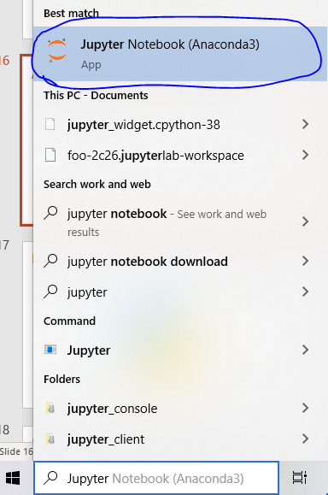
Anaconda/Python Installation Part 2 a – Launching Jupyter Notebook
Now that Anaconda is installed, let’s try launching the Jupyter Notebook IDE (integrated development environment)
Click the “Type here to search” box next to the magnifying glass in the bottom left of your screen and search for Jupyter; click on the Jupyter notebook icon circled to the right

Slide 3
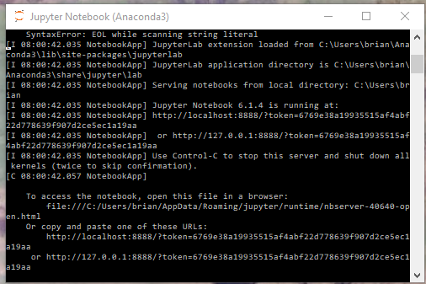
Anaconda/Python Installation Part 2 b – Launching Jupyter Notebook
After clicking the icon, a black command prompt will appear; don’t worry! You don’t need to type anything here; you do need to keep this window open for your entire Jupyter session and you’ll want to close it when you’re done interacting with Jupyter or if you ever want to restart Jupyter.

Slide 4
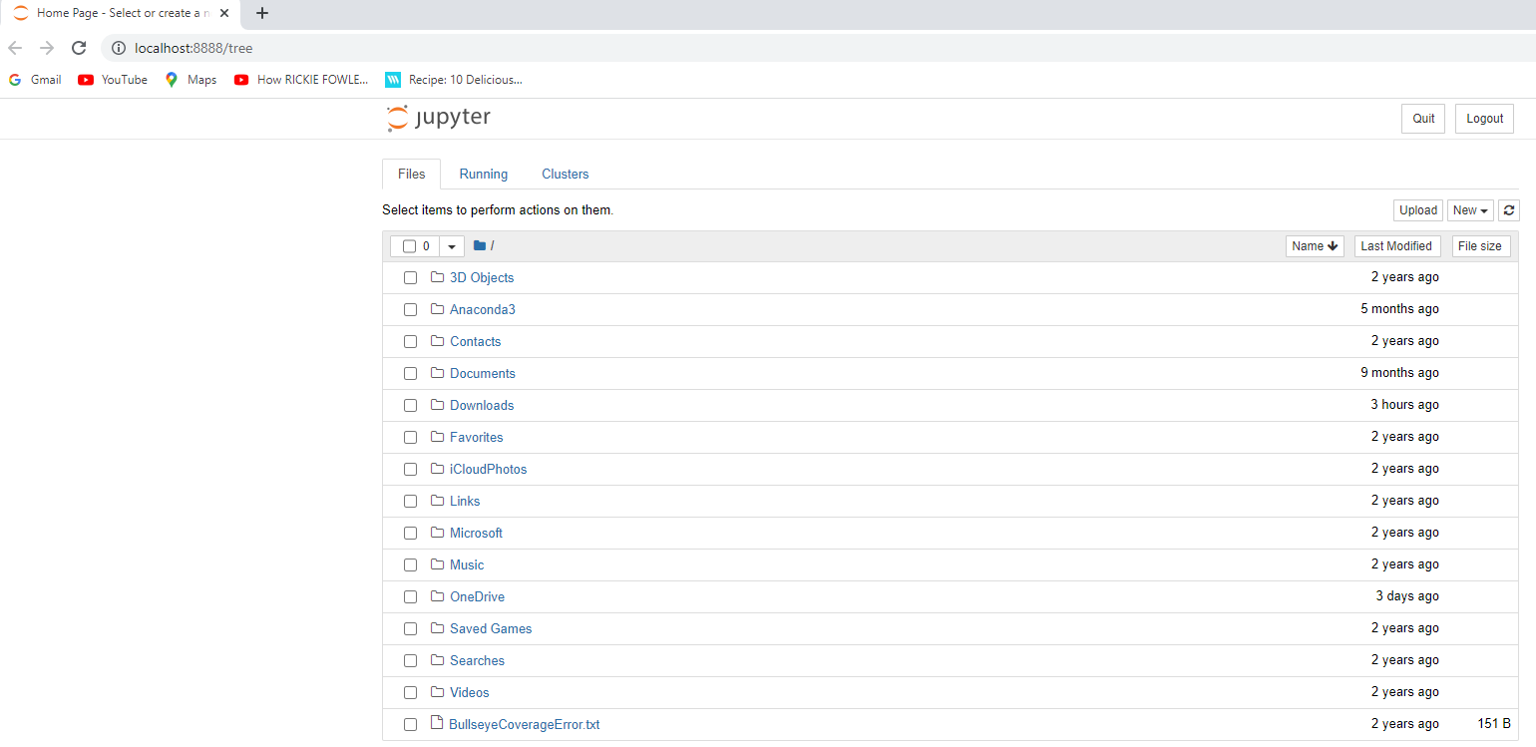
Anaconda/Python Installation Part 2 c – Launching Jupyter Notebook
After a few seconds, a new Jupyter “Home Page” window should launch in your browser (see screenshot on right)
This is the navigation page for Jupyter and the folders/files should mirror a folder location on your PC
If you get any kind of error or the new window doesn’t show up in your browser, you may need to download the Chrome browser and set it to your default browser. Then, close the Jupyter terminal window from the prior slide, and try searching for and launching Jupyter again (2 slides prior)

Slide 5
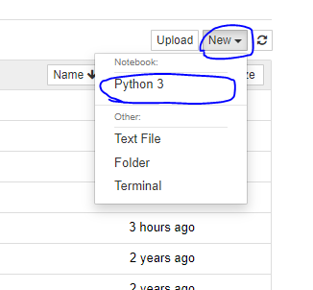
Anaconda/Python Installation Part 3 a – Creating a New Jupyter Notebook
From the Jupyter “Home Page” that launched in your browser, you can click on the name of a folder to navigate to another folder where you’d like to create a new Jupyter notebook if you wish
When you’ve reached the folder you wish to create it in (you could also just create the new Jupyter notebook in the default folder the Jupyter Home Page opens up on), click “New” in the top right of the Home Page and then “Python 3”

Slide 6
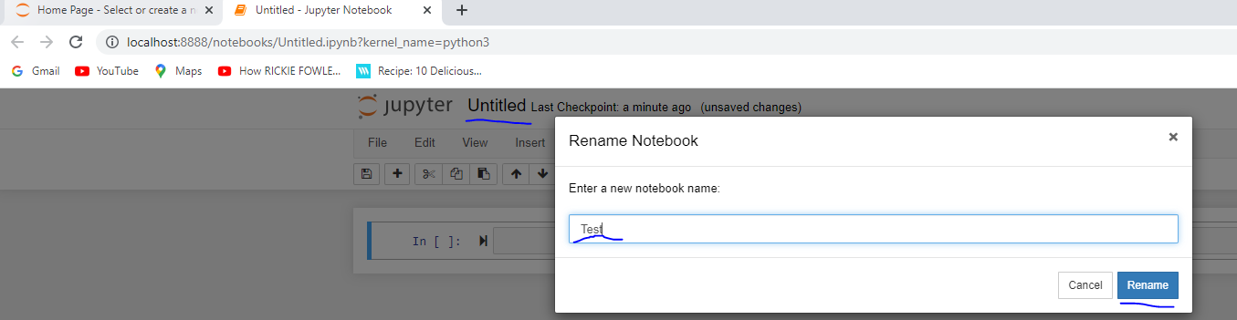
Anaconda/Python Installation Part 3 b – Creating a New Jupyter Notebook
After clicking “Python 3”, a new window in your browser should appear called “Untitled”; you can rename this by clicking on “Untitled”, giving it a new name in the pop up window, and clicking the rename button (see screenshot below)

Slide 7
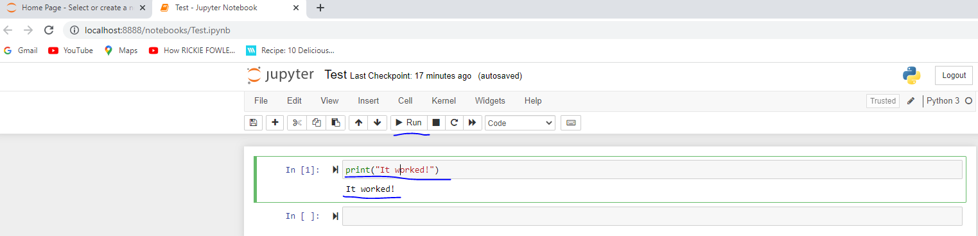
Anaconda/Python Installation Part 3 c – Creating a New Jupyter Notebook
Now let’s write and run perhaps your first line of Python code!
Type the following in the first code cell:
print(“It worked!”)
To run this code cell, click within the line to select it (the cell outline should turn green when this happens) and then click the Run button next to the play sign (or use keyboard shortcut Ctrl+Enter)
After this, you should see “It worked” printed below the first code cell

Slide 8
Anaconda/Python Installation Part 4 – Next Steps
Congratulations, you’ve officially written and ran some Python code!
We’ll pick up from here in the Python training session and learn about writing code to manipulate and graph data in Python
Feel free to do some web searches to try running other Python code in Jupyter in the meantime if you wish!

